Slide 1

Programming Languages
Third Edition
Chapter 13
Parallel Programming

Slide 2
Objectives
Understand the nature of parallel processing
Understand the relationship of parallel processing to programming languages
Understand threads
Understand semaphores
Understand monitors
Programming Languages, Third Edition

Slide 3
Objectives (cont’d.)
Understand message passing
Become familiar with parallelism in non-imperative languages
Programming Languages, Third Edition

Slide 4
Introduction
Parallel processing: executing many computations in parallel
Multiprogramming: many processes share a single processor, thus appearing to execute simultaneously (pseudoparallelism)
True parallelism: many processors are connected to run in concert
  Multiprocessor system: a single system incorporates all the processors
  Distributed system: a group of standalone processors connected by high-speed links
Programming Languages, Third Edition

Slide 5
Introduction (cont’d.)
Implementation of parallel processing is not simple, and parallel systems are relatively uncommon
High-speed networks, including the Internet, present new possibilities for using physically distant computers in parallel processing
Organized networks of independent computers can be viewed as a kind of distributed system for parallel processing
A comprehensive study of parallel processing is beyond the scope of this course
Programming Languages, Third Edition

Slide 6
Introduction (cont’d.)
Programming languages have affected and been affected by parallelism in several ways
Languages have been used to:
  Express algorithms to solve parallel processing issues
  Write operating systems for parallel processing
  Harness the capabilities of multiple processors to solve application problems efficiently
  Implement and express communication across networks
Programming Languages, Third Edition

Slide 7
Introduction (cont’d.)
Must also consider the basic ways that programmers have used programming languages to express parallelism
Must distinguish parallelism as expressed in a language, and the parallelism that actually exists in the underlying hardware
Programs that are written with parallel programming constructs do not necessarily result in actual parallel processing
  May be implemented by pseudoparallelism, even in a system with multiple processors
Programming Languages, Third Edition

Slide 8
Introduction (cont’d.)
Parallel programming is sometimes called concurrent programming
  Emphasizes the fact that parallel constructs express only the potential for parallelism
Programming Languages, Third Edition

Slide 9
Introduction to Parallel Processing
Process: the fundamental notion of parallel processing
  The basic unit of code executed by a processor
  An instance of a program or program part that has been scheduled for independent execution
Jobs: an earlier name for processes
In the early days, jobs were executed sequentially in batch fashion
  Only one process in existence at a time
Programming Languages, Third Edition

Slide 10
Introduction to Parallel Processing (cont’d.)
With the advent of pseudoparallelism, processes could exist simultaneously in one of three states:
  Executing: in possession of the processor
  Blocked: waiting for some activity, such as I/O, to complete
  Waiting: ready for the processor and waiting for it
The operating system needs to apply some algorithm to schedule processes and manage waiting and blocked processes
  Principal method for this is the hardware interrupt
Programming Languages, Third Edition

Slide 11
Introduction to Parallel Processing (cont’d.)
Heavyweight process: corresponds to the earlier notion of a program in execution
  Full-fledged independent entity, together with all the memory and other resources allocated to an entire program
Lightweight process: shares its resources with the program it comes from
  Does not have an independent existence
  Also called a thread
  Can be very efficient since there is less overhead in their creation and management
Programming Languages, Third Edition

Slide 12
Introduction to Parallel Processing (cont’d.)
In true parallel processing, each processor may individually be assigned to a process
  Each processor may or may not be assigned its own queues for maintaining blocked and waiting processes
Two primary requirements for the organization of processors in a parallel processing system:
  Must be a way for processors to synchronize their activity
  Must be a way for processors to communicate data among themselves
Programming Languages, Third Edition

Slide 13
Introduction to Parallel Processing (cont’d.)
Single-instruction, multiple-data (SIMD) systems: central control by one processor, with each other processor executing the same instructions on their respective registers or data sets
  Are multiprocessing rather than distributed systems
  May be synchronous, operating at the same speed, with the controlling processor determining when each instruction is executed
Programming Languages, Third Edition

Slide 14
Introduction to Parallel Processing (cont’d.)
Multiple-instruction, multiple-data (MIMD) systems: processors operator at different speeds and are asynchronous
  May be either multiprocessor or distributed processor systems
  Synchronization of the processors is a critical problem
Hybrid systems are also possible
Programming Languages, Third Edition

Slide 15
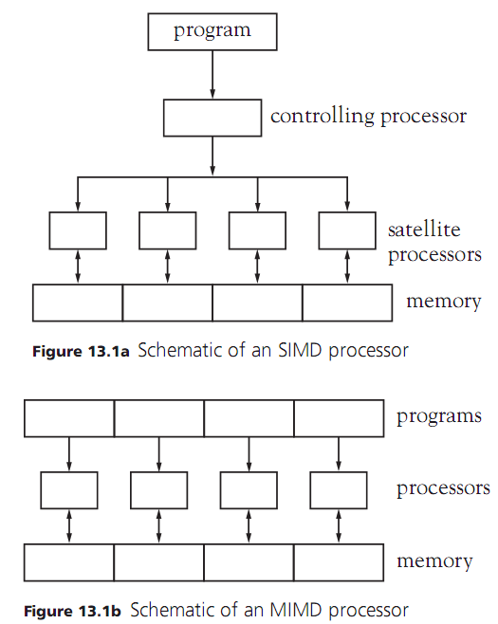
Programming Languages, Third Edition

Slide 16
Introduction to Parallel Processing (cont’d.)
Shared-memory system: one central memory is shared by all processors
  By nature, this is a multiprocessor rather than a distributed system
In a shared-memory system:
  Processors communicate through changes made to shared memory
  Each processor must have exclusive access to those areas of memory that it is changing, to avoid race conditions
Programming Languages, Third Edition

Slide 17
Introduction to Parallel Processing (cont’d.)
Race condition: when different processes modify the same memory in unpredictable ways
  Solving the mutual exclusion problem typically means blocking processes when one is already accessing shared data, using a locking mechanism
Deadlock: occurs when processes end up waiting for each other to unblock
  Detecting or preventing deadlock is a difficult problem in parallel processing
Programming Languages, Third Edition

Slide 18
Introduction to Parallel Processing (cont’d.)
Distributed-memory system: each processor has its own independent memory
  In distributed-memory systems, each processor has its own memory that is inaccessible to other processors
Distributed processors have a communication problem
  Each must be able to send and receive messages from all other processes asynchronously
  Processes may block while waiting for a needed message
Programming Languages, Third Edition

Slide 19
Introduction to Parallel Processing (cont’d.)
Communication depends on the configuration of links between processors
  Processors may be connected in sequence, and need to forward information to other processors farther along the link
  If few processors, they may be fully linked to each other
Deadlock problems in a distributed-memory system are also extremely difficult
  Each process may have little information about the status of other processes
Programming Languages, Third Edition

Slide 20
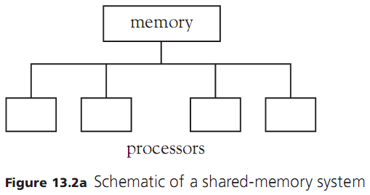
Introduction to Parallel Processing (cont’d.)
Programming Languages, Third Edition

Slide 21
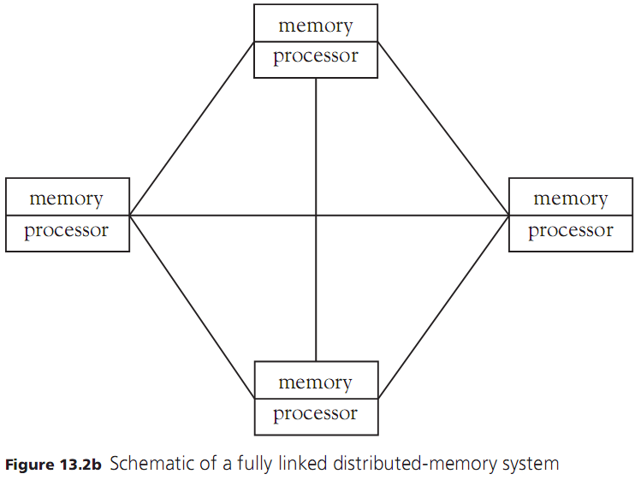
Programming Languages, Third Edition

Slide 22
Introduction to Parallel Processing (cont’d.)
It is possible for a system to be a hybrid between a shared and distributed-memory system
  Each processor maintains some private memory in addition to the shared memory
  Processors have some communication links separate from shared memory
It is the task of the operating system to integrate the operation of processors and to shield the user from needing to know too much about the configuration
Programming Languages, Third Edition

Slide 23
Introduction to Parallel Processing (cont’d.)
In general, an operating system should provide:
  A means of creating and destroying processes
  A means of managing the number of processors used by processes
  On a shared-memory system, a mechanism for ensuring mutual exclusion of processes to shared memory (for process synchronization and communication)
  On a distributed-memory system, a mechanism for creating and maintaining communication channels between processors
Programming Languages, Third Edition

Slide 24
Parallel Processing and Programming Languages
Some programming languages use the shared-memory model
  They provide facilities for mutual exclusion, usually via a built-in thread mechanism or thread library
Some languages assume the distributed model
  They provide communication facilities
A few languages include both models
A language may not include parallel mechanisms in its definition at all
  Parallel facilities may be provided in other ways
Programming Languages, Third Edition

Slide 25
Parallel Processing and Programming Languages (cont’d.)
We will discuss two approaches to shared-memory models:
  Threads
  Semaphores and monitors
We will discuss message passing for the distributed model
Two standard problems in parallel processing will be used to demonstrate these mechanisms:
  Bounded buffer problem
  Parallel matrix multiplication
Programming Languages, Third Edition

Slide 26
Parallel Processing and Programming Languages (cont’d.)
Bounded buffer problem: assumes that two or more processes are cooperating in a computational or input-output scenario
  One process produces values consumed by the other, using an intermediate buffer or buffer process
  No value must be produced until there is room to store it in the buffer
  A value is consumed only after it has been produced
This involves both communication and synchronization
Also called the producer-consumer problem
Programming Languages, Third Edition

Slide 27

Parallel Processing and Programming Languages (cont’d.)
Parallel matrix multiplication: an algorithmic application in which the use of parallelism can cause significant speedups
Matrices are essentially two-dimensional arrays
Example: with both dimensions of size N:
Programming Languages, Third Edition

Slide 28
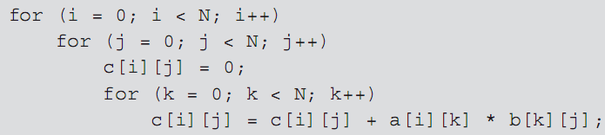
Parallel Processing and Programming Languages (cont’d.)
The standard way of multiplying two matrices a and b to form a third matrix c is done using nested loops:
If performed sequentially, this computation requires N³ steps
Programming Languages, Third Edition

Slide 29
Parallel Processing and Programming Languages (cont’d.)
If we assign a separate process to compute each c[i][j], and each process executes on a separate processor, then the computation requires only N steps
  This is the simplest form of the algorithm, because there are no write conflicts and no need to enforce mutual exclusion in accessing the matrices as shared memory
  There is a synchronization problem to ensure that c is not used until all processes have completed
Programming Languages, Third Edition

Slide 30
Parallel Programming without Explicit Language Facilities
One approach to parallelism is simply not to express it explicitly in a language
This is easiest in functional, logic, and object-oriented languages
  They have a certain amount of inherent parallelism implicit in the language constructs
Language translators may be able to automatically use operating system utilities to assign different processors to different parts of a program
  Manual facilities are still needed to make full, optimal use of parallel processors
Programming Languages, Third Edition

Slide 31
Parallel Programming without Explicit Language Facilities (cont’d.)
Second approach: the translator may offer compiler options to allow explicit indication of areas where parallelism is called for
  One of the most effective places is in the use of nested loops, since each repetition of the inner loop is relatively independent of the others
Example: compiler option in FORTRAN
Programming Languages, Third Edition

Slide 32
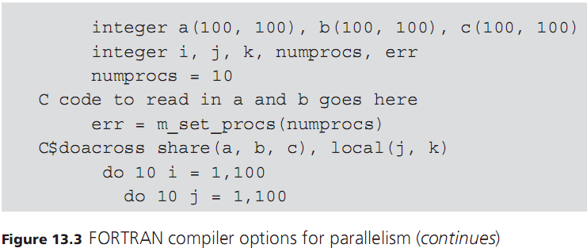
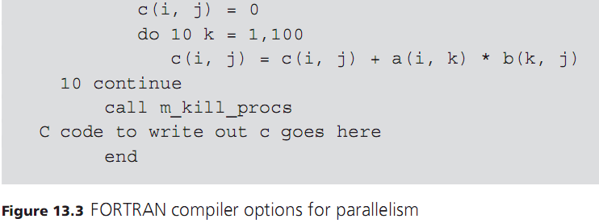
Programming Languages, Third Edition

Slide 33
Parallel Programming without Explicit Language Facilities (cont’d.)
Third approach: provide a library of functions to perform parallel processing
  This is a way of passing the facilities provided by an operating system directly to the programmer
If a standard parallel library is required by a language, then it is the same as including parallel facilities in the language definition
Example: using library functions in C to provide parallel processing for the matrix multiplication problem
Programming Languages, Third Edition

Slide 34
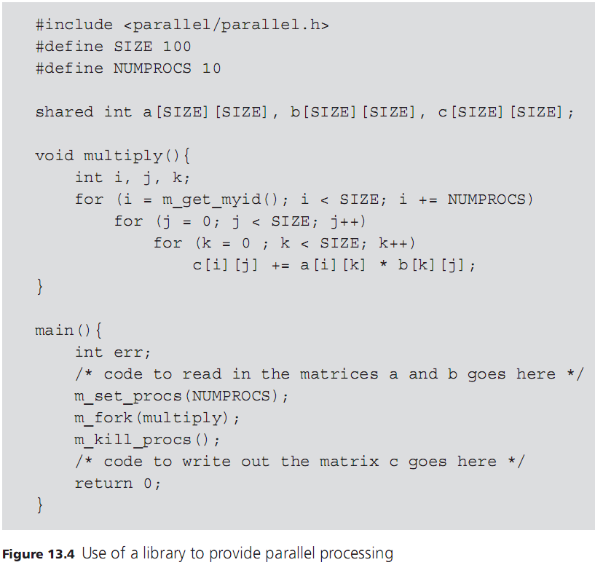
Programming Languages, Third Edition

Slide 35
Parallel Programming without Explicit Language Facilities (cont’d.)
Fourth approach: rely on operating system features directly to run programs in parallel
Requires that a parallel program be split into separate, independently executable pieces that are set up to communicate via operating system mechanisms
  Allows only program-level parallelism
Example: use of pipes in Unix to string programs together
Programming Languages, Third Edition

Slide 36
Process Creation and Destruction
A language with explicit mechanisms for parallel processing must have a construct for creating new processes
Two basic ways to create new processes
First approach: split the current process into two or more processes that continue to execute copies of the same program
  One process is called the parent, while the others are called children
  Processes can execute different code by testing some condition, but the basic program is the same
Programming Languages, Third Edition

Slide 37
Process Creation and Destruction (cont’d.)
This process resembles SIMD organization and is called SPMD programming (single program multiple data)
SPMD programs may execute different segments of their common code
  Do not necessarily operate synchronously, thus need process synchronization
Second approach: a segment of code (usually a procedure) is explicitly associated with each new process
  Different processes have different code
Programming Languages, Third Edition

Slide 38
Process Creation and Destruction (cont’d.)
This approach is called MPMD programming
Fork-join model: a process creates several child processes, each with its own code (fork), and then waits for the children to complete (a join)
Granularity of processes: relates to the size of the code that can become a separate process:
  Fine-grained: individual statements can become processes and be executed in parallel
  Medium-grained: procedures are assigned to processes
  Large-grained: whole programs are processes
Programming Languages, Third Edition

Slide 39
Process Creation and Destruction (cont’d.)
Granularity can be an efficiency issue:
  Many small-grained processes can incur significant overhead in creation and management
  Large-grained processes may have difficulty exploiting all opportunities for parallelism
Threads can be very efficient
  Represent fine-grained or medium-grained parallelism without the overhead of full-blown process creation
Programming Languages, Third Edition

Slide 40
Process Creation and Destruction (cont’d.)
Two questions for process creation mechanisms:
  Does the parent process suspend execution while its children are executing, or does it continue to execute alongside them?
  What memory, if any, does a parent share with its children, or the children share among themselves?
A parallel programming language also needs a method for process termination
  Process may simply terminate when done
  Process may need to wait for a condition to be met
  Process may need to be selected for continuing
Programming Languages, Third Edition

Slide 41
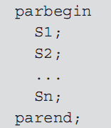
Statement-Level Parallelism
parbegin-parend block: a construct for indicating parallel execution for statements
Example: in Occam:
  Statements are all executed in parallel
  Assumes that the main process is suspended
  All processes of the Si share all variables not locally declared within an Si
Programming Languages, Third Edition

Slide 42
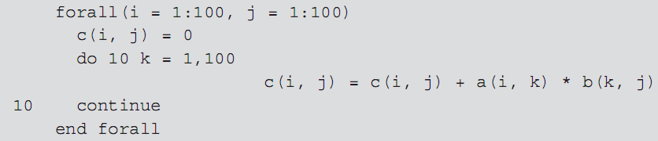
Statement-Level Parallelism (cont’d.)
forall construct in Fortran95: indicates parallel execution of each iteration of a loop
Example:
Programming Languages, Third Edition

Slide 43
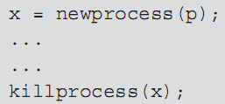
Procedure-Level Parallelism
When a procedure is associated with a process, the mechanism has this form:
  p is a declared procedure
  x is a process designator
Alternate way is to use declarations to associated procedures to processes:
Programming Languages, Third Edition

Slide 44
Procedure-Level Parallelism (cont’d.)
Scope of x can be used as the region where x is active
  x begins executing when the scope of its declaration is entered
  x is terminated on exit from its scope (if not already completed)
This is the method used by Ada
  A process is called a task in Ada
Programming Languages, Third Edition

Slide 45
Program-Level Parallelism
In this method of process creation, only whole programs can become processes
  Typically in MPMD style
  A program creates a complete copy of itself
Example: fork call of the UNIX operating system
  Creates a child process that is an exact copy of the calling process, including all variables and environment data at the moment of the fork
  The return value of the fork call indicates whether the process is the parent or child, which can be used to determine which code to execute
Programming Languages, Third Edition

Slide 46
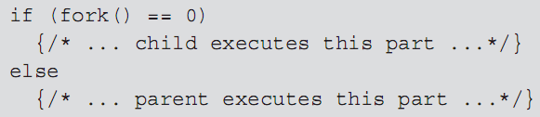
Program-Level Parallelism (cont’d.)
Example:
A process can be terminated by a call to exit
Process synchronization can be achieved by calls to wait, which suspends a parent until a child terminates
Example: parallel matrix multiplication in C code:
Programming Languages, Third Edition

Slide 47
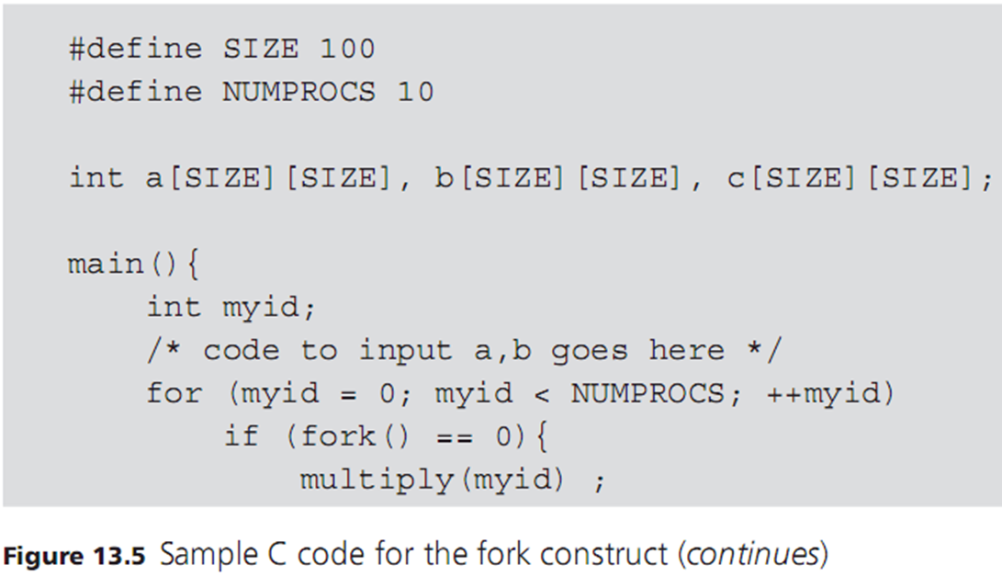
Program-Level Parallelism (cont’d.)
Programming Languages, Third Edition

Slide 48
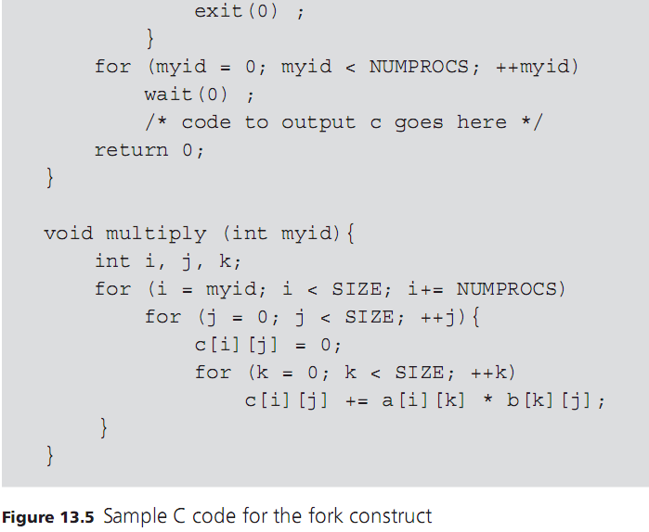
Programming Languages, Third Edition

Slide 49
Threads
Threads can be an efficient mechanism for fine- or medium-grained parallelism in the shared memory model
Java has a widely used thread implementation
Programming Languages, Third Edition

Slide 50
Threads in Java
Threads are built into the Java Language
  Thread class is part of java.lang package
  Reserved word synchronize is used to establish mutual exclusion for threads
To create a thread, instantiate a Thread object and define a run method in one of these ways:
  Extend Thread through inheritance and override the empty Thread.run method
  Instantiate an object of a class that implements the Runnable interface and pass it to the Thread constructor
Programming Languages, Third Edition

Slide 51
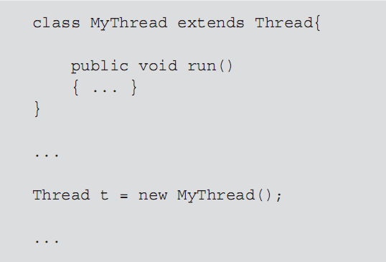
Threads in Java (cont’d.)
Example:
Programming Languages, Third Edition

Slide 52
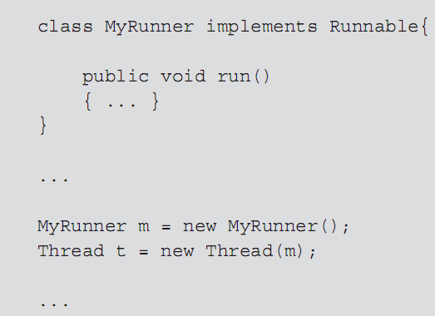
Threads in Java (cont’d.)
Example:
Programming Languages, Third Edition

Slide 53
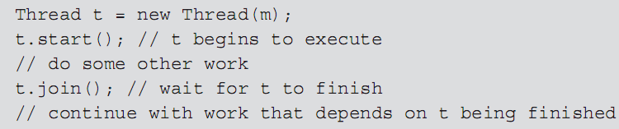
Threads in Java (cont’d.)
start method: begins running a thread and calls the run method
  Main program continues to execute, but entire program will not finish execution until all of its threads complete
join method: used to cause a thread to wait for another thread to finish before continuing
Programming Languages, Third Edition

Slide 54
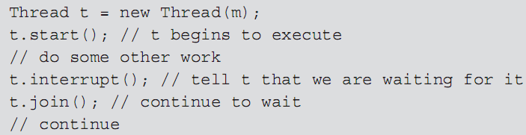
Threads in Java (cont’d.)
interrupt method: sets an internal flag in the thread object that received the interrupt
  Thread can test whether some other thread called its interrupt method
  Allows a thread to continue to execute some cleanup code before actually exiting
Programming Languages, Third Edition

Slide 55
Threads in Java (cont’d.)
Any method such as join that blocks the current thread has a timeout version
  Java runtime system makes no attempt to discover or prevent deadlock; it is up to the programmer
Java threads will share some memory or other resources by passing objects to be shared to constructors on the Runnable objects used to create threads
Programming Languages, Third Edition

Slide 56
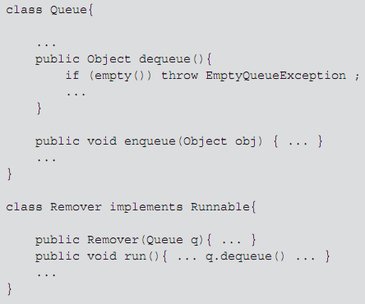
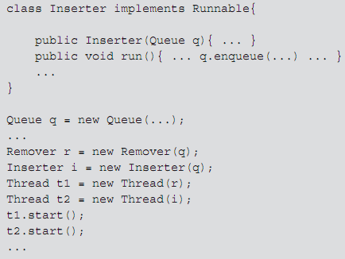
Threads in Java (cont’d.)
Queue q is shared between threads t1 and t2
Need a mechanism for ensuring mutual exclusion
Programming Languages, Third Edition

Slide 57
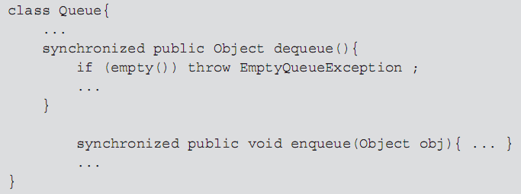
Threads in Java (cont’d.)
synchronize keyword is used for method synchronization
Example:
Programming Languages, Third Edition

Slide 58
Threads in Java (cont’d.)
Every object in Java has a single lock available to threads
When a thread attempts to execute a synchronized method, it must first acquire the lock on the object
  If lock is held by another thread, it must wait
  After exiting the method, it releases the lock
wait() method: used to manually stall a thread based on a testable condition
notify() or notifyAll() method: used to wake up a thread in a waiting condition
Programming Languages, Third Edition

Slide 59
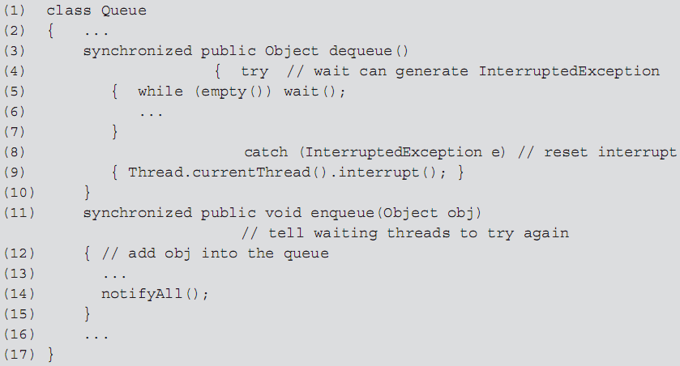
Threads in Java (cont’d.)
Programming Languages, Third Edition

Slide 60
A Bounded Buffer Example in Java
Bounded buffer example: the producer reads characters from standard input and inserts them into a buffer
The consumer removes characters from the buffer and writes them to standard output
Additional requirements:
  Producer thread will continue to read until an end of file is encountered, whence it will exit
  Consumer thread will continue to write until the producer has ended and the buffer is empty
Programming Languages, Third Edition

Slide 61
Semaphores
Semaphore: a mechanism to provide mutual exclusion and synchronization in a shared-memory model
  Is a shared integer variable that can be accessed only via three operations: InitSem, Signal, and Delay
Delay operation: tests the semaphore for a positive value
  Decrements it if it is positive
  Suspends the calling process if it is zero or negative
Programming Languages, Third Edition

Slide 62
Semaphores (cont’d.)
Signal operation: tests whether processes are waiting
  Causes one of them to continue if so
  Increments the semaphore if not
Signal is analogous to notify in Java, and Delay is analogous to wait
The system must ensure that each of these operations executes atomically (by only one process at a time)
Programming Languages, Third Edition

Slide 63

Semaphores (cont’d.)
Can ensure mutual exclusion by defining a critical region
Critical region: a region of code that can be executed by only one process at a time
Example:
Semaphores are sometimes called locks
  Can also be used to synchronize processes
Programming Languages, Third Edition

Slide 64
Semaphores (cont’d.)
An important question is the method used to choose a suspended process for continued execution when a call to Signal is made
Possibilities include:
  Making a random choice
  Using a first in, first out strategy
  Using some sort of priority system
This choice has a major effect on the behavior of concurrent programs using semaphores
Programming Languages, Third Edition

Slide 65
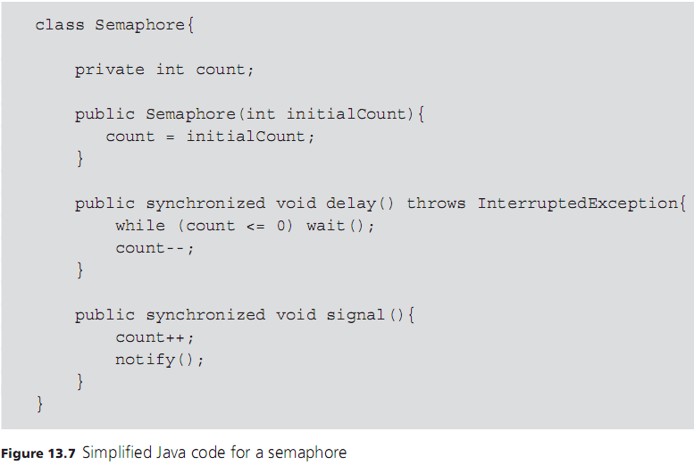
Semaphores (cont’d.)
Programming Languages, Third Edition

Slide 66
A Bounded Buffer Using Semaphores
Semaphores can be used to enforce synchronization and mutual exclusion
Use of semaphores can eliminate the need for Java synchronization mechanisms:
  Synchronized methods
  Calls to wait and notifyAll
Programming Languages, Third Edition

Slide 67
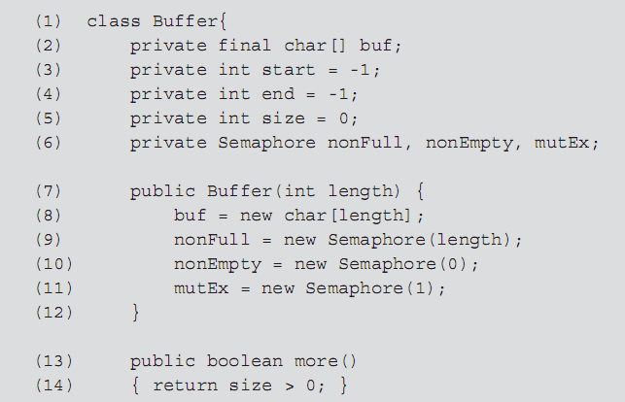
A Bounded Buffer Using Semaphores (cont’d.)
Programming Languages, Third Edition

Slide 68
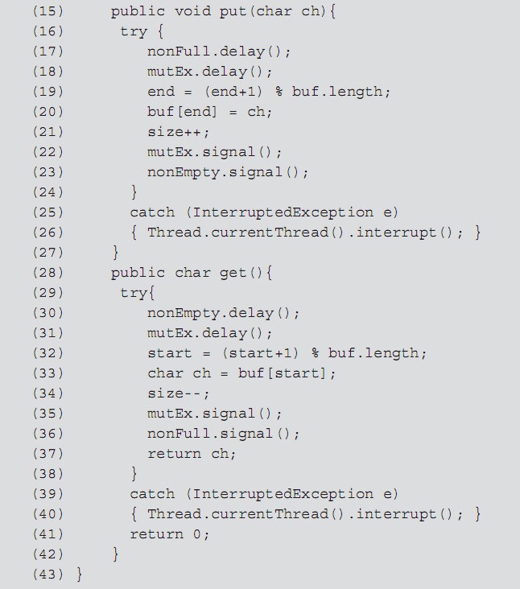
Programming Languages, Third Edition

Slide 69
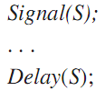

Difficulties with Semaphores
Although semaphores themselves are protected, there is no protection against their incorrect use by programmers
Example: failure to create a critical region:
Example: this process will likely block at the second Delay and never resume execution:
Programming Languages, Third Edition

Slide 70
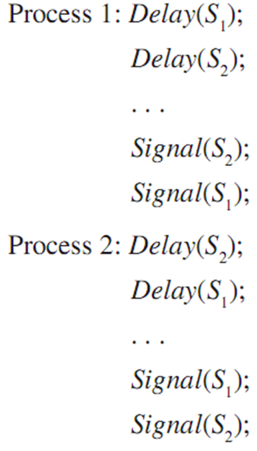
Difficulties with Semaphores (cont’d.)
Example: can cause deadlock:
  If Process 1 executes Delay(S₁) at the same time that Process 2 executes Delay(S₂), then each will block waiting for the other to issue a Signal
  Deadlock has occurred
The monitor was invented to remove some of these insecurities in the use of semaphores
Programming Languages, Third Edition

Slide 71

Implementation of Semaphores
Semaphores are generally implemented with some form of hardware support
Example: TestAndSet machine instruction on a single-processor system tests a memory location and simultaneously increments or decrements the location if the test succeeds
Assuming TestAndSet returns the value of its location parameter and decrements its location parameter if it is > 0, we can implement Signal and Delay with this code:
Programming Languages, Third Edition

Slide 72
Implementation of Semaphores (cont’d.)
This implementation causes a blocked process to busy-wait or spin in a while loop until S becomes positive again through a call to Signal by another process
  Semaphores implemented this way are sometimes called spin-locks
Leaves unresolved the order in which waiting processes are reactivated
  May be random, or in some order imposed by the operating system
Programming Languages, Third Edition

Slide 73
Implementation of Semaphores (cont’d.)
A waiting process may be preempted by many incoming calls to Delay from new processes, and never get to execute despite calls to Signal
  This situation is called starvation
Starvation is prevented by using a scheduling system that is fair
  Guarantees that every process will execute within a finite period of time
Avoiding starvation is more difficult than avoidance of deadlocks
Programming Languages, Third Edition

Slide 74
Implementation of Semaphores (cont’d.)
Modern shared-memory systems often provide facilities for semaphores that do not require busy-waiting
  Semaphores are special memory locations accessible by only one processor at a time, with a queue to store the processes that are waiting for it
Programming Languages, Third Edition

Slide 75
Monitors
Monitor: an abstract data type mechanism with the added property of mutual exclusion
  It encapsulates shared data and operations on these data
  At most, one process at a time can be using any of the monitor’s operations
Monitor has an associated wait queue to track processes that are waiting to use its operations
Programming Languages, Third Edition

Slide 76
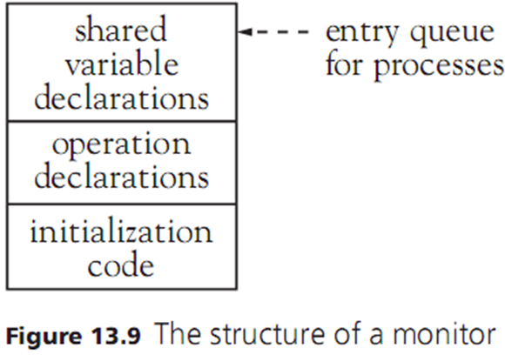
Monitors (cont’d.)
Programming Languages, Third Edition

Slide 77
Monitors (cont’d.)
Monitor must also provide condition variables to handle situations like the bounded buffer problem
Condition variables: shared variables within the monitor resembling semaphores
  Each has a queue of processes waiting for the condition
  Each has associated suspend and continue operations
If a condition queue is empty, a call to continue will have no effect
Suspend always suspends the current process
Programming Languages, Third Edition

Slide 78
Monitors (cont’d.)
When a continue call is issued to a waiting process by a process currently in the monitor, there are two choices:
  Suspended process just awakened by the continue call must wait until the calling process has left the monitor
  Process that issues the continue call must suspend until the awakened process has left the monitor
It is possible to imitate the behavior of a monitor using semaphores
Programming Languages, Third Edition

Slide 79
Monitors (cont’d.)
Monitors and semaphores are equivalent in terms of the kinds of parallelism they can express
Monitors provide a more structured mechanism for concurrency than semaphores, and they ensure mutual exclusion
  They cannot guarantee the absence of deadlock
Java and Ada have monitor-like mechanisms
Programming Languages, Third Edition

Slide 80
Java Synchronized Objects as Monitors
Java objects whose methods are synchronized are essentially monitors
  Sometimes called synchronized objects
Java provides an entry queue for each synchronized object
  A thread inside the synchronized object has a lock on the object
These Java queues do not operate in a fair fashion
Any unsynchronized methods may be executed without acquiring the lock or going through the entry queue
Programming Languages, Third Edition

Slide 81
Java Synchronized Objects as Monitors (cont’d.)
Java’s synchronized objects do not have separate condition variables
  Only one wait queue per synchronized object for any and all conditions
Java wait and sleep calls are suspend operations
Java notify and notifyAll calls are continue operations
When a thread comes off the wait queue, it must again acquire the object’s lock
  Awakened threads in Java must wait for the awakening thread to exit the synchronized code
Programming Languages, Third Edition

Slide 82
The Java Lock and Condition Interfaces
java.util.concurrent.locks package: includes interfaces and classes that support a more authentic monitor mechanism
  Programmer represents a monitor as an explicit lock object associated with a shared data resource
lock method: acquires the lock
unlock method: releases the lock
await method: wait for an explicit condition object
Multiple condition objects can be associated with a single lock
Programming Languages, Third Edition

Slide 83
The Java Lock and Condition Interfaces (cont’d.)
Each condition object has its own queue of threads waiting on it
When a method is finished, it can signal other threads waiting on a condition object by using the signal or signalAll methods
Programming Languages, Third Edition

Slide 84
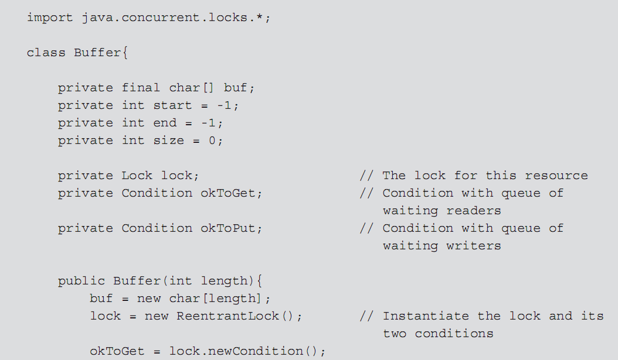
The Java Lock and Condition Interfaces (cont’d.)
Programming Languages, Third Edition

Slide 85
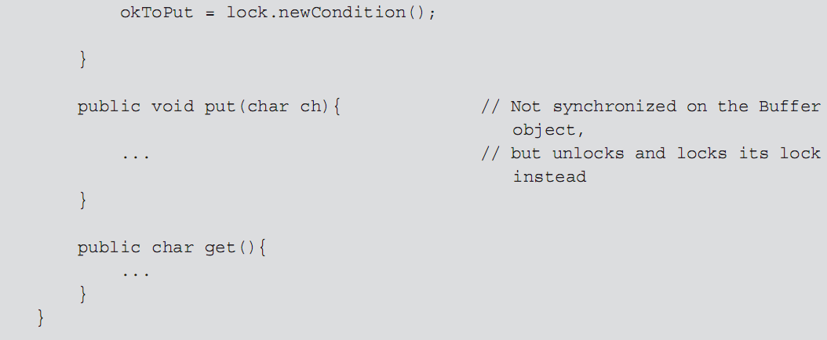
The Java Lock and Condition Interfaces (cont’d.)
Programming Languages, Third Edition

Slide 86
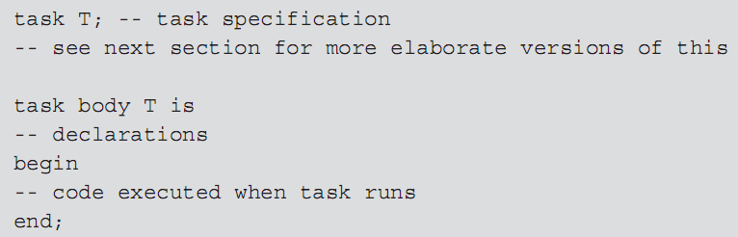
Ada95 Concurrency and Monitors
Concurrency in Ada is provided by independent processes called tasks
A task is declared using specification and body declaration similar to the package mechanism
Programming Languages, Third Edition

Slide 87
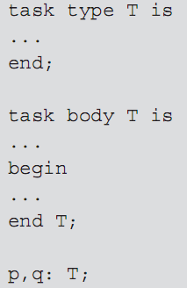
Ada95 Concurrency and Monitors (cont’d.)
An Ada task begins to execute as soon as the scope of its declaration is entered
When the end of the scope of the task declaration is reached, the program waits for the task to terminate before continuing execution
Can declare task types and variables
Programming Languages, Third Edition

Slide 88
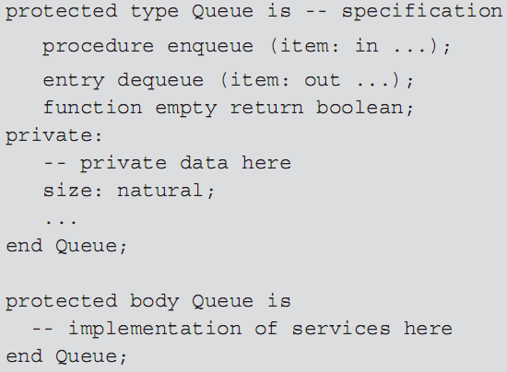
Ada95 Concurrency and Monitors (cont’d.)
Ada95 has monitors, called protected objects
  Correspond to synchronized objects in Java
Programming Languages, Third Edition

Slide 89
Ada95 Concurrency and Monitors (cont’d.)
Three kinds of operations within a protected object:
  Functions
  Procedures
  Entries
Functions may not change the local state of a protected object but can be executed by any number of callers
Procedures and entries may only be executed by a single caller at a time
No functions can execute simultaneously with a procedure or entry
Programming Languages, Third Edition

Slide 90
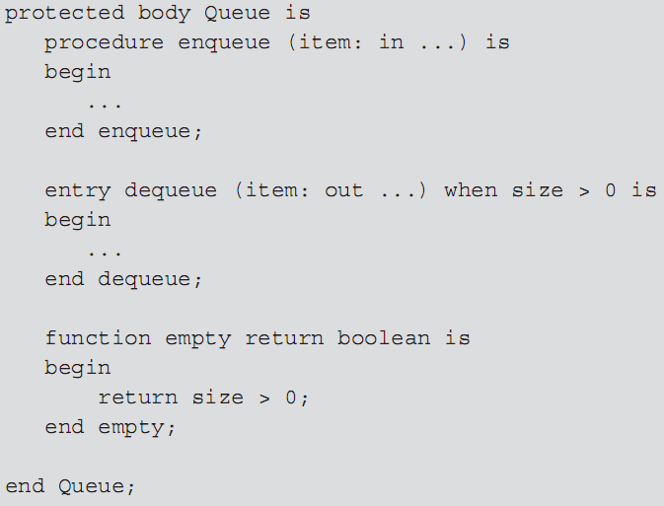
Ada95 Concurrency and Monitors (cont’d.)
Programming Languages, Third Edition

Slide 91
Ada95 Concurrency and Monitors (cont’d.)
A procedure can always be executed, while an entry can only be executed under a certain condition, called the entry barrier
  If the entry barrier is closed (false), the task is suspended and placed in a wait queue for that entry
Ada-protected object entries correspond to monitor condition variables
Ada runtime system automatically recomputes the entry barrier at appropriate times and wakes a waiting task
Programming Languages, Third Edition

Slide 92

Message Passing
Message passing: a mechanism for process synchronization and communication using the distributed model of parallel processing
In its most basic form, it consists of two operations, send and receive
Example: in C code:
  Assumes every sender knows its receiver and vice versa
  Must have names within scope of each other
Programming Languages, Third Edition

Slide 93

Message Passing (cont’d.)
Less restrictive form of send and receive removes the requirement to name sender and receiver
Example: in C code:
  A sent message will go to any process willing to receive it, and a message will be received from any sender
Commonly, a name is required for the send but not for the receive
Programming Languages, Third Edition

Slide 94
Message Passing (cont’d.)
Other questions to be answered revolve around synchronization of processes communicating with send and receive
  Must a sender wait for a receiver to be ready before sending a message, or can the sender continue to execute even if there is no available receiver? If so, are messages stored in a buffer for later receipt?
  Must a receiver wait until a message is available to be sent, or can a receiver receive a null message and continue to execute?
Programming Languages, Third Edition

Slide 95
Message Passing (cont’d.)
Rendezvous mechanism: when both sender and receiver must wait until the other is ready
  If messages are buffered, must determine if there is a size limit on the buffer, and who manages the buffer
Mailbox mechanism: a separate process manages the buffer, where processes drop off and receive messages from named (or numbered) mailboxes
  Mailbox may be assigned an owner process that manages it
Programming Languages, Third Edition

Slide 96
Message Passing (cont’d.)
Control facilities: permit processes to test for messages, to accept messages only on certain conditions, and to select specific messages
Various forms of message passing include:
  Hoare’s Communicating Sequential Processes (CSP) language framework and occam language
  Remote Procedure Call (RPC) or Remote Method Invocation (RMI) in Java
  CORBA (Common Object Request Broker Architecture)
  COM (Common Object Model)
Programming Languages, Third Edition

Slide 97
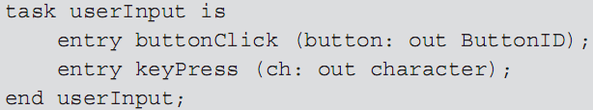
Task Rendezvous in Ada
Ada tasks can pass messages to each other via a rendezvous mechanism
Task entries: define rendezvous points
A task exports entry names to the outside world
Entries do not have code bodies but must appear inside an accept statement that provides the code to be executed
Programming Languages, Third Edition

Slide 98
Task Rendezvous in Ada (cont’d.)
Accept statements can only appear inside the body of a task
  Caller of an entry waits for the task to reach a corresponding accept statement
  A task that reaches an accept statement waits for a corresponding call
Each entry has an associated queue to maintain processes that are waiting for an accept statement to be executed
  This is a FIFO queue
Programming Languages, Third Edition

Slide 99
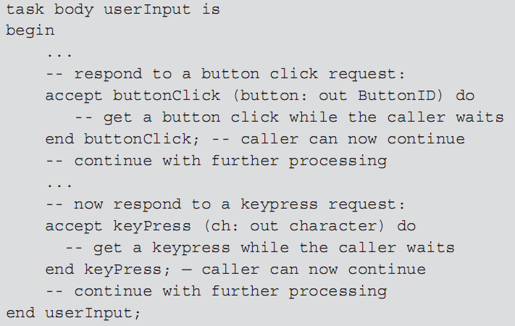
Task Rendezvous in Ada (cont’d.)
Programming Languages, Third Edition

Slide 100
Task Rendezvous in Ada (cont’d.)
A task that operates as a server for other client tasks will maintain a set of entries that it will accept and wait for one of these entries to be called
A select statement is used for the set of entries
  All conditions in the select statement are evaluated
  Those that are true have the corresponding select alternatives tagged as open
  An open accept statement is selected for execution if another task has executed an entry call for its entry
Programming Languages, Third Edition

Slide 101
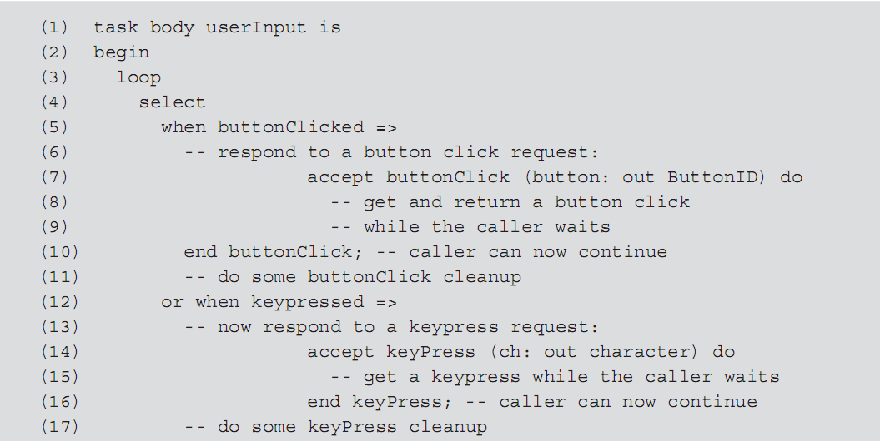

Programming Languages, Third Edition

Slide 102
Task Rendezvous in Ada (cont’d.)
Termination of tasks in Ada can occur in two ways:
  Task executes to completion and has not created any child processes that are still executing
  Task is waiting with an open terminate alternative in a select statement, and its master has executed to completion
Master: the block of the parent task in which a task was created
  All tasks created by the same master must also have terminated or be waiting at a terminate alternative (they will all terminate simultaneously)
Programming Languages, Third Edition

Slide 103
Task Rendezvous in Ada (cont’d.)
Tasks cannot have functions that return values
  Must return values through parameters in entries
Programming Languages, Third Edition

Slide 104
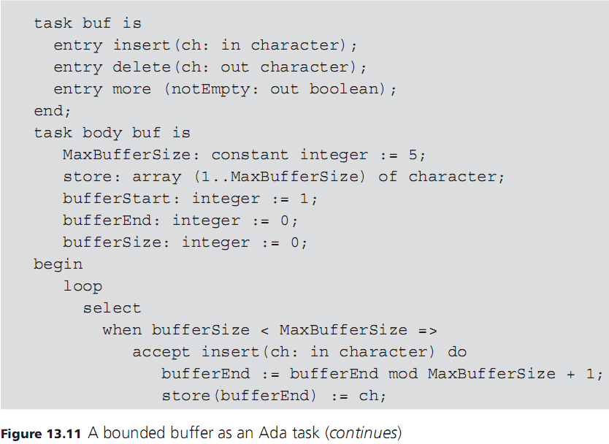
Programming Languages, Third Edition

Slide 105
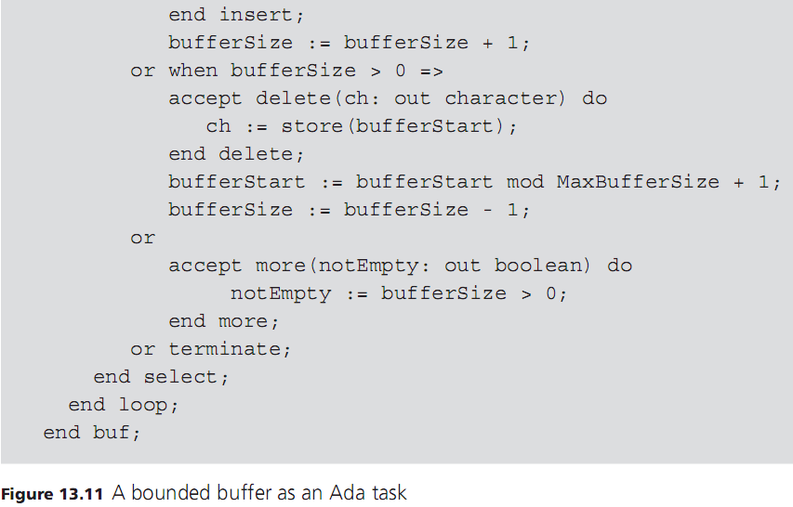
Programming Languages, Third Edition

Slide 106
Programming Languages, Third Edition

Slide 107
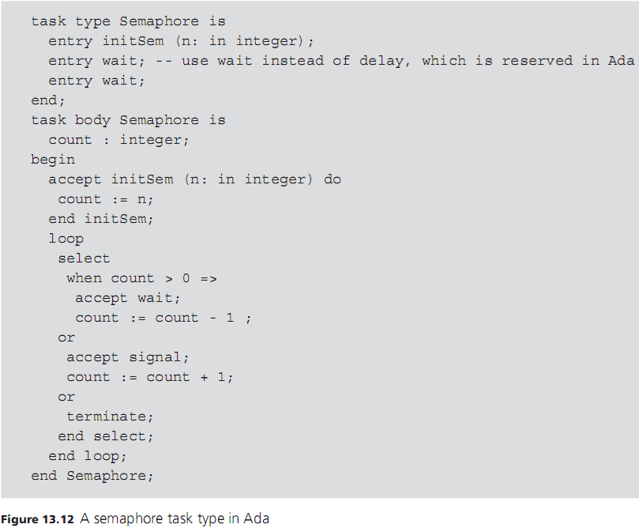
Programming Languages, Third Edition

Slide 108
Parallelism in Non-Imperative Languages
Parallel processing in functional or logic programming languages is still in an experimental and research phase
A number of good implementations of research proposals exist, including MultiLisp, Qlisp, Parlog, and FGHC
Erlang: a non-imperative language that supports message-passing
Programming Languages, Third Edition

Slide 109
And-Parallelism
In and-parallelism, a number of values are computed in parallel by child processes, while the parent process waits for them to finish and return their values
Example: a process calls a function in Lisp:
  Can create six parallel processes to compute the values of f, a, … e
  Suspends execution until all values are computed
  Then calls the (function) value of f with the returned values of a through e as arguments
Programming Languages, Third Edition

Slide 110
And-Parallelism (cont’d.)
In a let-binding:
  The values of e1, e2, and e3 can be computed in parallel
In Prolog:
  p1 through pn can be executed in parallel
  q succeeds if all the pi succeed
Noninterference is guaranteed since the evaluation of arguments in a purely functional language causes no side effects
Most functional languages are not pure, however
Programming Languages, Third Edition

Slide 111
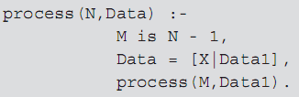
And-Parallelism (cont’d.)
Example: in Prolog:
  Cannot be executed in parallel since each of the first two goals contribute instantiations to the last
  Synchronization is needed here
Programming Languages, Third Edition

Slide 112
Or-Parallelism
In or-parallelism, execution of several alternatives can occur in parallel, with the first to finish (or succeed) causing all other alternative processes to be ignored (and to terminate)
Example: in Lisp:
Or-parallelism makes the cond into a nondeterministic construct, which may change the overall behavior of the program if the order of evaluation is significant
Programming Languages, Third Edition

Slide 113

Or-Parallelism (cont’d.)
In Prolog, a system may try to satisfy alternative clauses for a goal simultaneously
Example: if there are two or more clauses for the same predicate:
  The correct execution of a program may depend on the order in which the alternatives are tried
Synchronization and order problems are difficult to solve automatically by a translator
Some language designers have included some manual parallel constructs
Programming Languages, Third Edition

Slide 114
Parallelism in Lisp
And-parallelism is most often implemented in Lisp
MultiLisp offers parallel evaluation of function calls with the pcall construct:
  Provides parallel evaluation of its subexpressions
Future: a construct that returns a point to the value of a not-yet-finished parallel computation
Example: in MultiLisp:
  Allows execution of f to proceed before the values of a and b have been computed
  When the values are needed, it suspends evaluation until they are available
Programming Languages, Third Edition

Slide 115
Parallelism in Prolog
The more natural form for Prolog is or-parallelism, although both forms have been implemented
Or-parallelism fits well with the semantics of logic programming
  Often performed automatically by a parallel Prolog system
One version of and-parallelism uses guarded Horn clauses to eliminate backtracking
Example:
  The g1,…gn are guards that are executed first and prohibited from establishing instantiations
Programming Languages, Third Edition

Slide 116

Parallelism in Prolog (cont’d.)
If the guards succeed, the system commits to this clause for h, and the p1,…pm are executed in parallel
  Such a system is FGHC (flat guarded Horn clauses)
Example: FGHC program
  Generates lists of integers
Programming Languages, Third Edition

Slide 117
Parallelism in Prolog (cont’d.)
FGHC places severe constraints on variable instantiation and thus on unification
  A significant reduction in the expressiveness of the language
Variable annotations: specify the kind of instantiations allowed and when they may occur
Parlog: a language that does this
Mode declaration: distinguishes input variables from output variables
  “?” for input and “^” for output
Programming Languages, Third Edition

Slide 118
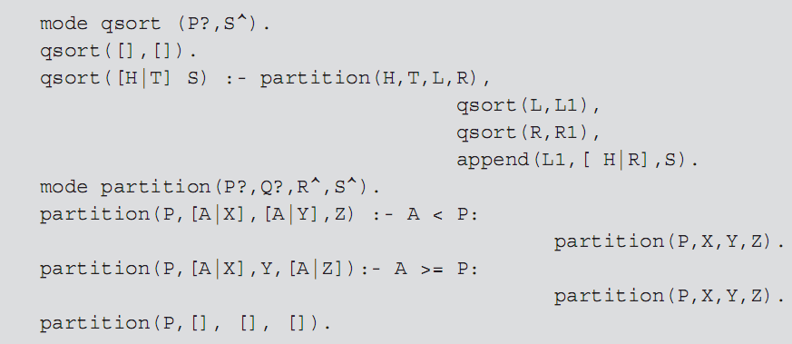
Parallelism in Prolog (cont’d.)
Example: quicksort in Parlog:
Programming Languages, Third Edition

Slide 119
Parallelism in Prolog (cont’d.)
Parlog selects an alternative from among clauses by the usual unification process and also by using guards
  It then commits to one alternative
Programming Languages, Third Edition

Slide 120
Parallelism with Message Passing in Erlang
Erlang: developed by Ericcson for distributed, fault-tolerant, real-time applications needed in the telecommunications industry
  Uses strict evaluation and dynamic typing
  Its syntax is similar to that of Haskell, with powerful pattern-matching capability
Erlang’s additional features include:
  Variable binding via single assignment
  Distinguishes between atoms and variables
  Supports concurrency and parallelism based on message passing
Programming Languages, Third Edition

Slide 121
Parallelism with Message Passing in Erlang (cont’d.)
Absence of side effects and the presence of message passing produces a very simple model of parallel programming in Erlang
Erlang implementation includes an interactive interpreter and a compiler
Programming Languages, Third Edition

Slide 122
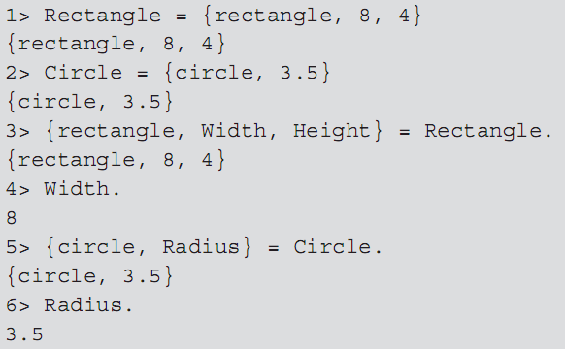
Parallelism with Message Passing in Erlang (cont’d.)
Example: in Erlang code:
Programming Languages, Third Edition

Slide 123
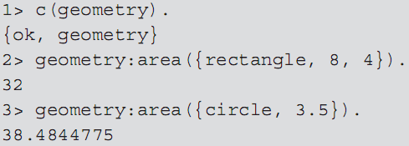
Parallelism with Message Passing in Erlang (cont’d.)
Pattern matching and variable binding form the basis of function applications in Erlang
  Example: creates a geometry module:
  Example: compiles and tests the geometry module
Programming Languages, Third Edition

Slide 124
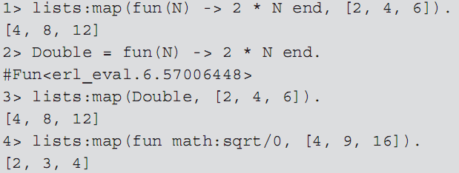
Parallelism with Message Passing in Erlang (cont’d.)
Functions can be passed as arguments to other functions, with mapping:
fun: a special type of function, used like lambda to build an anonymous function to pass as an argument
Programming Languages, Third Edition

Slide 125
Parallelism with Message Passing in Erlang (cont’d.)
An Erlang process is a lightweight software object that runs independently of any other process
  Communicates with other processes via messages
Spawn: creates a new process
Send: sends messages to other processes
Receive: receives messages
A function can act as a server that executes in its own process
  A client makes a request of this server
Programming Languages, Third Edition

Slide 126
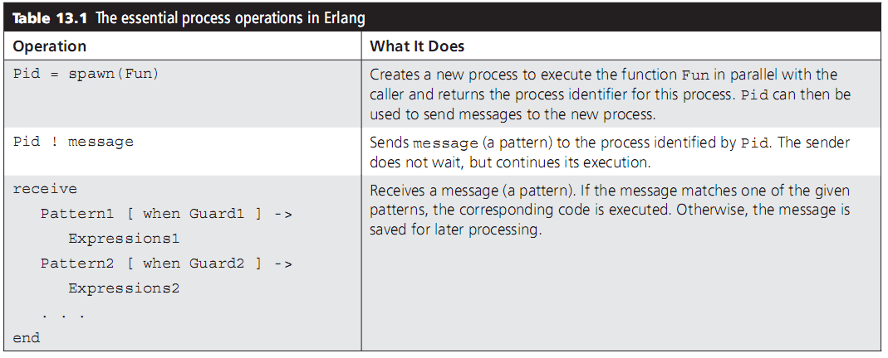
Parallelism with Message Passing in Erlang (cont’d.)
Programming Languages, Third Edition

Slide 127
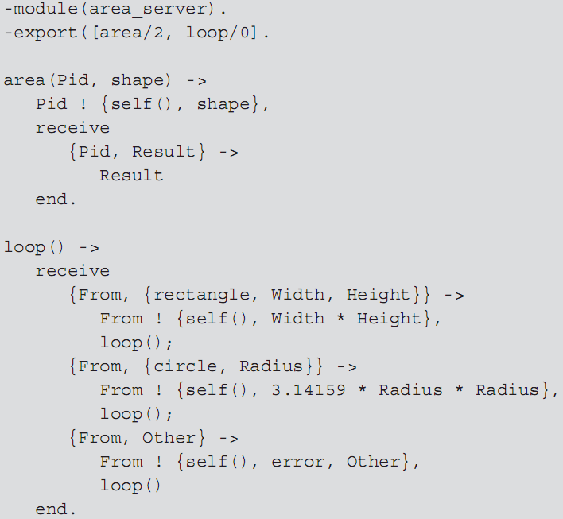
Programming Languages, Third Edition

Slide 128
Parallelism with Message Passing in Erlang (cont’d.)
Interactions between processes are not always tightly coupled
  A process may hand off work to other processes and go on without waiting for a response
  A process may wait longer than is desirable to receive a message (if the server has a problem)
Receiver process can include an after clause to time out the receive operation
Programming Languages, Third Edition

Slide 129
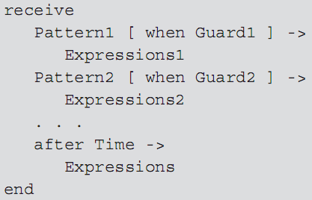
Parallelism with Message Passing in Erlang (cont’d.)
Example: receive operation:
Mailbox: a queue-like data structure associated with a process
Programming Languages, Third Edition

Slide 130
Parallelism with Message Passing in Erlang (cont’d.)
To remove a message from its mailbox, the process’s receive operation must be able to match the message to one of its patterns
  It a match occurs, the message is removed from the mailbox and discarded, and the expressions in the clause are executed
  If not, the message is removed and put at the rear of the process’s save queue
If the mailbox becomes empty or a timeout occurs, the process is suspended until a new message arrives
Programming Languages, Third Edition

Slide 131
Parallelism with Message Passing in Erlang (cont’d.)
When a new message arrives, the process itself is rescheduled for execution to examine the message
  If a match, all messages in the saved queue are transferred to the mailbox in their original order
Erlang includes resources for developing distributed applications to run on a network of independent computers
Independent processes are embedded in software objects called nodes, which allow messages to be sent and received across a network of machines
Programming Languages, Third Edition

